Slide 1
Mastering Enterprise JavaBeans
Anmol Arora, 19th November 2020

Slide 2
Contents
Introduction
Part One Overview
Overview
The Motivation for EJB
Divide and Conquer to the Extreme
Component Architectures
Introducing Enterprise JavaBeans
Why Java
EJB as a Business Solution
The EJB Ecosystem
The Bean Provider
The Application Assembler
The EJB Deployer
The System Administrator
The Container and Server Provider
The Tool Vendors
Summary of Roles

Slide 3
The Java 2 Platform, Enterprise Edition (J2EE)
The J2EE Technologies
Summary
EJB Fundamentals
Enterprise Beans
Types of Beans
Distributed Objects: The Foundation for EJB
Distributed Objects and Middleware
Explicit Middleware
Implicit Middleware
What Constitutes an Enterprise Bean?
The Enterprise Bean Class
The EJB Object
The Home Object
The Local Interfaces
Deployment Descriptors
Vendor-Specific Files
Ejb-Jar File
Summary of Terms
Summary

Slide 4
Writing Your First Bean
How to Develop an EJB Component
The Remote Interface
The Local Interface
The Home Interface
The Local Home Interface
The Bean Class
The Deployment Descriptor
The Vendor-Specific Files
The Ejb-jar File
Deploying the Bean
The Optional EJB Client JAR file
Understanding How to Call Beans
Looking up a Home Object
Running the System
The Server-Side Output
The Client-Side Output
Implementing Component Interfaces
A Solution
Summary

Slide 5
Part Two The Triad of Beans
Introduction to Session Beans
Session Bean Lifetime
Session Bean Subtypes
Stateful Session Beans
Stateless Session Beans
Special Characteristics of Stateful Session Beans
Achieving the Effect of Pooling with Stateful Beans
The Rules Governing Conversational State
Activation and Passivation Callbacks
Method Implementation Summary
A Simple Stateful Session Bean
Life Cycle Diagrams for Session Beans
Summary

Slide 6
Introduction to Entity Beans
Persistence Concepts
Java Object Serialization
Object-Relational Mapping
Object Databases
What Is an Entity Bean?
About the Files that Make up an Entity Bean
Features of Entity Beans
Entity Beans Survive Failures
Entity Bean Instances Are a View into a Database
Several Entity Bean Instances May Represent the Same Underlying Data
Entity Bean Instances Can Be Pooled
There Are Two Ways to Persist Entity Beans
Creation and Removal of Entity Beans
Entity Beans Can Be Found
You Can Modify Entity Bean Data without Using EJB
Entity Contexts
getEJBLocalObject() / getEJBObject()
getPrimaryKey()
Summary

Slide 7
Writing Bean-Managed Persistent Entity Beans
Entity Bean Coding Basics
Finding Existing Entity Beans: ejbFind()
Bean-Managed Persistence Example: A Bank Account
Account.java
AccountLocal.java
AccountHome.java
AccountLocalHome.java
AccountPK.java
AccountBean.java
AccountException.java
Client.java
The Deployment Descriptor
The Container-Specific Deployment Descriptor
Setting up the Database
Running the Client Program
Server-Side Output
Client-Side Output
Putting It All Together: Walking through a BMP Entity Bean’s Life Cycle
Summary

Slide 8
Writing Container-Managed Persistent Entity Beans
Features of CMP Entity Beans
CMP Entity Beans Are Subclassed
CMP Entity Beans Have No Declared Fields
CMP Get/Set Methods Are Defined in the Subclass
CMP Entity Beans Have an Abstract Persistence Schema
CMP Entity Beans Have a Query Language
CMP Entity Beans Can Have ejbSelect() Methods
Implementation Guidelines for Container-Managed Persistence
Container-Managed Persistence Example: A Product Line
Product.java
ProductLocal.java
ProductHome.java
ProductLocalHome.java
ProductPK.java
ProductBean.java
The Deployment Descriptor
The Container-Specific Deployment Descriptor
Client.java
Running the Client Program
The Life Cycle of a CMP Entity Bean
Summary

Slide 9
Introduction to Message-Driven Beans
Motivation to Use Message-Driven Beans
The Java Message Service (JMS)
Messaging Domains
The JMS API
Integrating JMS with EJB
What Is a Message-Driven Bean?
Developing Message-Driven Beans
The Semantics
A Simple Example
Advanced Concepts
Message-Driven Bean Gotchas
Message Ordering
Missed ejbRemove() Calls
Poison Messages
How to Return Results Back to Message Producers
The Future: Asynchronous Method Invocations
Summary

Slide 10
Adding Functionality to Your Beans
Calling Beans from Other Beans
Default JNDI Lookups
Understanding EJB References
Resource Factories
Environment Properties
Understanding EJB Security
Security Step 1: Authentication
Security Step 2: Authorization
Security Propagation
Understanding Handles
Home Handles
Summary

Slide 11
Part Three Advanced Enterprise JavaBeans Concepts
Transactions
Motivation for Transactions
Atomic Operations
Network or Machine Failure
Multiple Users Sharing Data
Benefits of Transactions
The ACID Properties
Transactional Models
Flat Transactions
Nested Transactions
Other Transactional Models
Enlisting in Transactions with Enterprise JavaBeans
Underlying Transaction System Abstraction
Declarative, Programmatic, and Client-Initiated Transactions
Choosing a Transaction Style
Container-Managed Transactions
EJB Transaction Attribute Values
Programmatic Transactions in EJB
CORBA’s Object Transaction Service (OTS)
The Java Transaction Service (JTS)
The Java Transaction API (JTA)
Declarative versus Programmatic Transactions Example
Transactions from Client Code
Transactional Isolation
The Need for Concurrency Control
Isolation and EJB
The Dirty Read Problem
The Unrepeatable Read Problem
The Phantom Problem
Transaction Isolation Summary
Isolation and EJB
Pessimistic and Optimistic Concurrency Control
Distributed Transactions
Durability and the Two-Phase Commit Protocol
The Transactional Communications Protocol and Transaction Contexts
Designing Transactional Conversations in EJB
Summary

Slide 12
BMP and CMP Relationships
The CMP and BMP Difference
Cardinality
1:1 Relationships
1:N Relationships
M:N Relationships
Directionality
Implementing Directionality with BMP
Implementing Directionality with CMP
Directionality May Not Map to Database Schemas
Bidirectional or Unidirectional?
Lazy Loading
Aggregation vs. Composition and Cascading Deletes
Relationships and EJB-QL
Recursive Relationships
Circular Relationships
Referential Integrity
Relationships, Referential Integrity, and Client Code
Summary

Slide 13
Persistence Best Practices
When to Use Entity Beans
Control 362 Parameter Passing Analogy
Procedural Versus Object-Oriented
Caching
Enforcement of Schema Independence
Ease of Use
Migration
Rapid Application Development
Choosing between CMP and BMP
Code Reduction and Rapid Application Development
Performance
Bugs
Control
Application Server and Database Independence
Relationships
Learning Curve and Cost
Choosing the Right Granularity for Entity Beans
Persistence Tips and Tricks
Beware the Object-Relational Impedance Mismatch
Hard-Coded Versus Soft-Coded SQL
When to Use Stored Procedures
Normalizing and Denormalizing
Use Your EJB Object Model to Drive Your Data Model
Follow a Good Data Design Process
Use Surrogate Keys
Understand the Impacts of Database Updates
Versioning EJB Components
Living with a Legacy Database Design
Handling Large Result Sets
Summary

Slide 14
EJB Best Practices and Performance Optimizations
When to Use Stateful versus Stateless
When to Use Messaging versus RMI-IIOP
How to Guarantee a Response Time with Capacity Planning
How to Achieve Singletons with EJB
Wrap Entity Beans with Session Beans
Performance-Tuning Entity Beans
Choosing between Local Interfaces and Remote Interfaces
How to Debug EJB Issues
Partitioning Your Resources
Assembling Components
Developing Components to Be Reusable
When to Use XML in an EJB System
Legacy Integration with EJB
Summary

Slide 15
Clustering
Overview of Large-Scale Systems
What Is a Large-Scale System?
Basic Terminology
Partitioning Your Clusters
Instrumenting Clustered EJBs
How EJBs Can Be Clustered
The Concept of Idempotence
Stateless Session Bean Clustering
Stateful Session Bean Clustering
Entity Bean Clustering
Message-Driven Bean Clustering
Other EJB Clustering Issues
First Contact
Initial Access Logic
Summary

Slide 16
Starting Your EJB Project on the Right Foot
Get the Business Requirements Down
Decide Whether J2EE is Appropriate
Decide Whether EJB Is Appropriate
Staff Your Project
Design Your Complete Object Model
Implement a Single Vertical Slice
Choose an Application Server
Divide Your Team
Invest in Tools
Invest in a Standard Build Process
Next Steps
Summary

Slide 17
Choosing an EJB Server
J2EE 1.3 Brand
Pluggable JRE
Conversion Tools
Complex Mappings
Third-Party JDBC Driver Support
Lazy-Loading
Deferred Database Writes
Pluggable Persistence Providers
In-Memory Data Cache
Integrated Tier Support
Scalability
High Availability
Security
IDE Integration
UML Editor Integration
Intelligent Load Balancing
Stateless Transparent Fail-over
Clustering
Java Management Extension (JMX)
Administrative Support
Hot Deployment
Instance Pooling
Automatic EJB Generation
Clean Shutdown
Real-Time Deployment
Distributed Transactions
Superior Messaging Architecture
Provided EJB Components
J2EE Connector Architecture (JCA)
Web Services
Workflow
Open Source
Specialized Services
Nontechnical Criteria
Summary

Slide 18
EJB-J2EE Integration: Building a Complete Application
The Business Problem
A Preview of the Final Web Site
Scoping the Technical Requirements
Object Model for the Business Logic Tier
Object Model for the Presentation Tier
Example Code
Summary

Slide 19
RMI-IIOP and JNDI Tutorial
Java RMI-IIOP
Remote Method Invocations
The Remote Interface
The Remote Object Implementation
Stubs and Skeletons
Object Serialization and Parameter Passing
Passing By-Value
Object Serialization
What Should You Make Transient?
Object Serialization and RMI-IIOP
The Java Naming and Directory Interface (JNDI)
Naming and Directory Services
Problems with Naming and Directories
Enter JNDI
Benefits of JNDI
JNDI Architecture
JNDI Concepts
Programming with JNDI
Integrating RMI-IIOP and JNDI
Binding an RMI-IIOP Server to JNDI
Looking up an RMI-IIOP Server with JNDI
Summary

Slide 20
CORBA Interoperability
What Is CORBA?
CORBA as the Basis for EJB
Why Should I Care about CORBA?
Drawbacks of CORBA
Understanding How CORBA Works
Object Request Brokers
OMG’s Interface Definition Language
OMG IDL Maps to Concrete Languages
CORBA Static Invocations
CORBA’s Many Services
The Need for RMI-IIOP
The Need for RMI-CORBA Interoperability
Combining RMI with CORBA
Steps to Take for RMI and CORBA to Work Together: An Overview
RMI-IIOP Client with a CORBA Object Implementation
CORBA Client with an RMI-IIOP Object Implementation
Bootstrapping with RMI-IIOP and CORBA
The Big Picture: CORBA and EJB Together
Sample Code
Summary

Slide 21
Deployment Descriptor Reference
How to Read a DTD
The Header and Root Element
Defining Session Beans
<session>
Defining Entity Beans
<entity>
<cmp-field>
<query>
<query-method>
<method-params>
Defining Message-Driven Beans
<message-driven>
<message-driven-destination>
Defining Environment Properties
<env-entry>
Defining EJB References
<ejb-ref>
<ejb-local-ref>
Defining Security
<security-role-ref>
<security-identity>
<run-as>
Defining Resource Factories
<resource-ref>
<resource-env-ref>
Defining Relationships
<relationships>
<ejb-relation>
<ejb-relationship-role>
<relationship-role-source>
<cmr-field>
Defining the Assembly Descriptor
<assembly-descriptor>
<security-role>
<method-permission>
<container-transaction>
<exclude-list>
<method>
<method-params>

Slide 22
The EJB Query Language (EJB-QL)
Overview
A Simple Example
The Power of Relationships
EJB-QL Syntax
The FROM Clause
The WHERE Clause
The SELECT Clause
Truth Tables
Final Note
Summary

Slide 23
EJB Quick Reference Guide
Session Bean Diagrams
Stateless Session Bean Diagrams
Stateful Session Bean Diagrams
Entity Bean Diagrams
Message-Driven Bean Diagrams
EJB API Reference
EJBContext
EJBHome
EJBLocalHome
EJBLocalObject
EJBMetaData
EJBObject
EnterpriseBean
EntityBean
EntityContext
Handle
HomeHandle
MessageDrivenBean
MessageDrivenContext
SessionBean
SessionContext
SessionSynchronization
Exception Reference
Transaction Reference

Slide 24
From Here
Now that we’ve gotten the logistics out of the way, let’s begin our exploration of Enterprise JavaBeans with Part 1, an introduction to EJB concepts and programming.

Slide 25
Part One Overview

Slide 26
In Part 1, we introduce the server-side development platform that is the Java 2 Platform, Enterprise Edition (J2EE), of which the Enterprise JavaBeans (EJB) component architecture is a vital piece. J2EE is a conglomeration of concepts, programming standards, and innovations—all written in the Java programming language. With J2EE, you can rapidly construct distributed, scalable, reliable, and portable secure server-side deployments.

Slide 27
Overview

Slide 28
Enterprise JavaBeans (EJB) is a server-side component architecture that simplifies the process of building enterprise-class distributed component applications in Java. By using EJB, you can write scalable, reliable, and secure applications without writing your own complex distributed component framework. EJB is about rapid application development for the server side; you can quickly and easily construct server-side components in Java by leveraging a prewritten distributed infrastructure provided by the industry. EJB is designed to support application portability and reusability across any vendor’s enterprise middleware services.

Slide 29
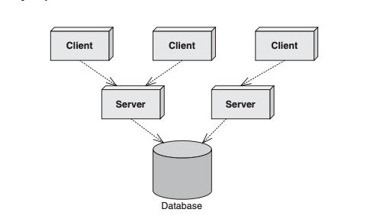
The Motivation for EJB
Figure shows a typical business application. This application could exist in any vertical industry and could solve any business problem. Here are some examples:
■■ A stock trading system
■■ A banking application
■■ A customer call centre
■■ A procurement system
■■ An insurance risk analysis application
Standard multi-tier deployment

Slide 30
The Motivation for EJB
Notice that this application is a distributed system. We broke up what would normally be a large, monolithic application and divorced each layer of the application from the others, so that each layer is completely independent and distinct.
Take a look at this picture, and ask yourself the following question based purely on your personal experience and intuition: If we take a monolithic application and break it up into a distributed system with multiple clients connecting to multiple servers and databases over a network, what do we need to worry about now (as shown in Figure)?

Slide 31
The Motivation for EJB
The application server was born to let you buy these middleware services, rather than build them yourself. Application servers provide you with common middleware services, such as resource pooling, networking, and more. Application servers allow you to focus on your application and not worry about the middleware you need for a robust server-side deployment. You write the code specific to your vertical industry and deploy that code into the runtime environment of an application server. You’ve just solved your business problem by dividing and conquering.

Slide 32
Divide and Conquer to the Extreme
We’ve just discussed how you can gain your middleware from an application server, empowering you to focus on your business problem. But there’s even better news: You may be able to buy a partial solution to the business problem itself.
To achieve this, you need to build your application out of components. A component is code that implements a set of well-defined interfaces. It is a manageable, discrete chunk of logic. Components are not entire applications—they cannot run alone. Rather, they can be used as puzzle pieces to solve some larger problem.

Slide 33
Divide and Conquer to the Extreme
The idea of software components is very powerful. A company can purchase a well-defined module that solves a problem and combine it with other components to solve larger problems. For example, consider a software component that computes the price of goods. We’ll call this a pricing component. You hand the pricing component information about a set of products, and it figures out the total price of the order.

Slide 34
Divide and Conquer to the Extreme
The pricing problem can get quite hairy. For example, let’s assume we’re ordering computer parts, such as memory and hard drives. The pricing component figures out the correct price based on a set of pricing rules that may include:
Base prices of a single memory upgrade or a single hard disk
Quantity discounts that a customer receives for ordering more than 10 memory modules
Bundling discounts that the customer receives for ordering both memory and a hard disk
Preferred customer discounts that you can give to big-name customers
Locale discounts depending on where the customer lives
Overhead costs such as shipping and taxes

Slide 35
Divide and Conquer to the Extreme
These pricing rules are in no way unique to ordering computer parts. Other industries, such as health care, appliances, airline tickets, and others need the same pricing functionality. Obviously, it would be a huge waste of resources if each company that needed complex pricing had to write its own sophisticated pricing engine. Thus, it makes sense that a vendor provides a generic pricing component that can be reused for different customers. For example:

Slide 36
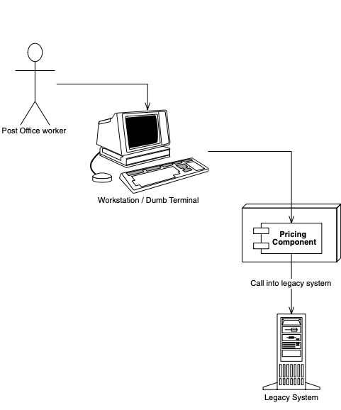
Divide and Conquer to the Extreme
The U.S. Postal Service can use the pricing component to compute shipping costs for mailing packages. This is shown in Figure.
Reusing a pricing component for the U.S. Postal Service

Slide 37
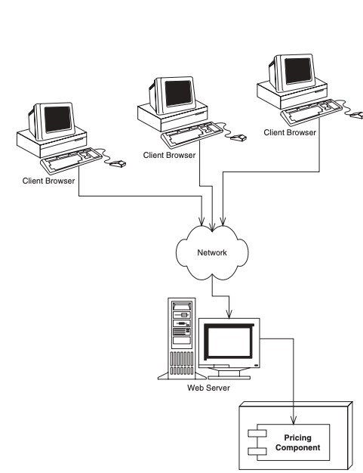
Divide and Conquer to the Extreme
An automobile manufacturer can use the pricing component to determine prices for cars. This manufacturer may set up a Web site that allows customers to get price quotes for cars over the Internet. Figure illustrates this scenario.
Reusing a pricing component for quoting car prices over the Internet

Slide 38
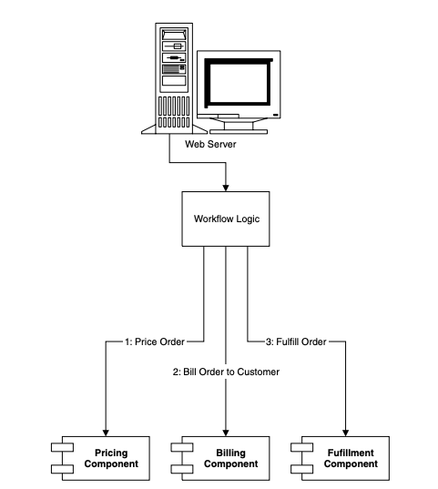
Divide and Conquer to the Extreme
An online grocery store can use the pricing component as one discrete part of a complete workflow solution. When a customer purchases groceries over the Web, the pricing component first computes the price of the groceries. Next, a different vendor’s component bills the customer with the generated price. Finally, a third component fulfills the order, setting things in motion for the groceries to be delivered to the end user. We depict this in Figure.
Reusing a pricing component as part of an e-commerce workflow solution

Slide 39
Divide and Conquer to the Extreme
Reusable components are quite enticing because components promote rapid application development. An IT shop can quickly assemble an application from prewritten components rather than writing the entire application from scratch. This means:
The IT shop needs less in-house expertise. The IT shop can consider the pricing component to be a black box, and it does not need experts in complex pricing algorithms.
The application is assembled faster. The component vendor has already written the tough logic, and the IT shop can leverage that work, saving development time.

Slide 40
Divide and Conquer to the Extreme
There is a lower total cost of ownership. The component vendor’s cash cow is its components, and therefore it must provide top-notch documentation, support, and maintenance if it is to stay in business. Because the component vendor is an expert in its field, the component generally has fewer bugs and higher performance than an IT shop’s home-grown solution. This reduces the IT shop’s maintenance costs.
Once the rules of engagement have been laid down for how components should be written, a component marketplace is born, where vendors can sell reusable components to companies. The components are deployed within application servers, which provide the needed middleware.

Slide 41
Divide and Conquer to the Extreme
Things to Consider When Building Large Business Systems
By now you should have a decent list of things you’d have to worry about when building large business systems. Here’s a short list of the big things we came up with. Don’t worry if you don’t understand all of them yet—you will.
■■ Remote method invocations. We need logic that connects a client and server via a network connection. This includes dispatching method requests, brokering of parameters, and more.
■■ Load balancing. Clients must be directed to the server with the lightest load. If a server is overloaded, a different server should be chosen.
■■ Transparent fail-over. If a server crashes, or if the network crashes, can clients be rerouted to other servers without interruption of service? If so, how fast does fail-over happen? Seconds? Minutes? What is acceptable for your business problem?
■■ Back-end integration. Code needs to be written to persist business data into databases as well as integrate with legacy systems that may already exist.
■■ Transactions. What if two clients access the same row of the database simultaneously? Or what if the database crashes? Transactions protect you from these issues.
■■ Clustering. What if the server contains state when it crashes? Is that state replicated across all servers, so that clients can use a different server?
■■ Dynamic redeployment. How do you perform software upgrades while the site is running? Do you need to take a machine down, or can you keep it running?
■■ Clean shutdown. If you need to shut down a server, can you do it in a smooth, clean manner so that you don’t interrupt service to clients who are currently using the server?
■■ Logging and auditing. If something goes wrong, is there a log that we can consult to determine the cause of the problem? A log would help us debug the problem so it doesn’t happen again.

Slide 42
Divide and Conquer to the Extreme
Things to Consider When Building Large Business Systems
■■ Systems Management. In the event of a catastrophic failure, who is monitoring our system? We would like monitoring software that paged a system administrator if a catastrophe occurred.
■■ Threading. Now that we have many clients connecting to a server, that server is going to need the capability of processing multiple client requests simultaneously. This means the server must be coded to be multi-threaded.
■■ Message-oriented middleware. Certain types of requests should be message-based where the clients and servers are very loosely coupled. We need infrastructure to accommodate messaging.
■■ Object life cycle. The objects that live within the server need to be created or destroyed when client traffic increases or decreases, respectively
■■ Resource pooling. If a client is not currently using a server, that server’s precious resources can be returned to a pool to be reused when other clients connect. This includes sockets (such as database connections) as well as objects that live within the server.
■■ Security. The servers and databases need to be shielded from saboteurs. Known users must be allowed to perform only operations that they have rights to perform.
■■ Caching. Let’s assume there is some database data that all clients share and make use of, such as a common product catalog. Why should your servers retrieve that same catalog data from the database over and over again? You could keep that data around in the servers’ memory and avoid costly network roundtrips and database hits.
■■ And much, much, much more.
Each of these issues is a separate service that needs to be addressed for serious server-side computing. These services are needed in any business problem and in any vertical industry. And each of these services requires a lot of thought and a lot of plumbing to resolve. Together, these services are called middleware.

Slide 43
Divide and Conquer to the Extreme
Is a Component Marketplace a Myth?
There is a very small component marketplace today. For years we’ve been hoping that the marketplace will explode, but it is behind schedule. There are several reasons for Independent Software Vendors (ISVs) not shipping components:
Maturity. Because components live inside application servers, the application servers must be mature before we see components written to those servers.
Politics. Many ISVs have written their own application servers. Some (falsely) view this as a competitive advantage.
Questionable value. Most ISVs are customer-driven (meaning they prioritize what their customers are asking for). Since components are new to many customers, many of them are not asking for their ISVs to support components.

Slide 44
Component Architectures
It has been a number of years since the idea of multi-tier server-side deployments surfaced. Since then, well over 50 application servers have appeared on the market. At first, each application server provided component services in a nonstandard, proprietary way. This occurred because there was no agreed definition of what a component should be. The result? Once you bet on an application server, your code was locked into that vendor’s solution. This greatly reduced portability and was an especially tough pill to swallow in the Java world, which promotes openness and portability. It also hampered the commerce of components, because a customer could not combine a component written to one application server with another component written to a different application server.

Slide 45
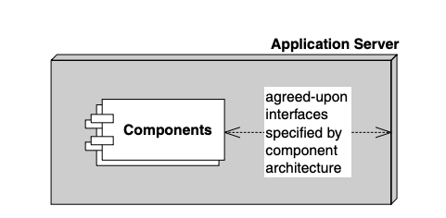
Component Architectures
What we need is an agreement, or set of interfaces, between application servers and components. This agreement will enable any component to run within any application server. This will allow components to be switched in and out of various application servers without having to change code or potentially even recompile the components themselves. Such an agreement is called component architecture and is shown in Figure.
A component architecture

Slide 46
Component Architectures
If you’re trying to explain components to a non-techie, try these analogies:
■■ Any CD player can play any compact disc because of the CD standard. Think of an application server as a CD player and components as compact discs.
■■ In the United States, any TV set can tune into any broadcast because of the NTSC standard. Think of an application server as a TV set and components as television broadcasts.

Slide 47
Introducing Enterprise JavaBeans
The Enterprise JavaBeans (EJB) standard is a component architecture for deployable server-side components in Java. It is an agreement between components and application servers that enable any component to run in any application server. EJB components (called enterprise beans) are deployable, and can be imported and loaded into an application server, which hosts those components.
The top three values of EJB are as follows:
It is agreed upon by the industry. Those who use EJB will benefit from its widespread use. Because everyone will be on the same page, in the future it will be easier to hire employees who understand your systems (since they may have prior EJB experience), learn best practices to improve your system (by reading books), partner with businesses (since technology will be compatible), and sell software (since customers will accept your solution). The concept of “train once, code anywhere” applies.

Slide 48
Introducing Enterprise JavaBeans
Portability is easier. The EJB specification is published and available freely to all. Since EJB is a standard, you do not need to gamble on a single, proprietary vendor’s architecture. And although portability will never be free, it is cheaper than without a standard.
Rapid application development. Your application can be constructed faster because you get middleware from the application server. There’s also less of a mess to maintain.

Slide 49
Introducing Enterprise JavaBeans
Physically, EJB is actually two things in one:
A specification. This is a 500-plus-page Adobe Acrobat PDF file, freely downloadable from http://java.sun.com. This specification lays out the rules of engagement between components and application servers. It constricts how you program so that you can interoperate.
A set of Java interfaces. Components and application servers must conform to these interfaces. Since all components are written to the same interfaces, they all look the same to the application server. The application server therefore can manage anyone’s components. You can freely download these interfaces from http://java.sun.com.

Slide 50
Introducing Enterprise JavaBeans
Why Java?
EJB components must be written in Java only and require dedication to Java. This is indeed a serious restriction. The good news, however, is that Java is an ideal language to build components, for many reasons.
Interface/implementation separation. We need a clean interface/implementation separation to ship components. After all, customers who purchase components shouldn’t be messing with implementation. Upgrades and support will become horrendous. Java supports this at a syntactic level via the interface keyword and class keyword.

Slide 51
Introducing Enterprise JavaBeans
Why Java?
Safe and secure. The Java architecture is much safer than traditional programming languages. In Java, if a thread dies, the application stays up. Pointers are no longer an issue. Memory leaks occur much less often. Java also has a rich library set, so that Java is not just the syntax of a language but a whole set of prewritten, debugged libraries that enable developers to avoid reinventing the wheel in a buggy way. This safety is extremely important for mission-critical applications. Sure, the overhead required to achieve this level of safety might make your application slower, but 90 percent of all business programs are glorified Graphical User Interfaces (GUIs) to databases. That database is going to be your number one bottleneck, not Java.
Cross-platform. Java runs on any platform. Since EJB is an application of Java, this means EJB should also easily run on any platform. This is valuable for customers who have invested in a variety of powerful hardware, such as Win32, UNIX, and mainframes. They do not want to throw away these investments.

Slide 52
Introducing Enterprise JavaBeans
Why Java?
If you don’t want to go the EJB route, you have two other choices as well:
■■ Microsoft’s .NET managed components, part of the Microsoft.NET platform
■■ The Object Management Group (OMG’s) Common Object Request Broker Architecture (CORBA)
Note that many EJB servers are based upon and can interoperate with CORBA.

Slide 53
Introducing Enterprise JavaBeans
EJB as a Business Solution
EJB is specifically used to help solve business problems. EJB components (enterprise beans) might perform any of the following tasks.
Perform business logic. Examples include computing the taxes on the shopping cart, ensuring that the manager has authority to approve the purchase order, or sending an order confirmation email using the JavaMail API.
Access a database. Examples include submitting an order for books, transferring money between two bank accounts, or calling a stored procedure to retrieve a trouble ticket in a customer support system. Enterprise beans achieve database access using the Java Database Connectivity (JDBC) API.
Access another system. Examples include calling a high-performing CICS legacy system written in COBOL that computes the risk factor for a new insurance account, calling a legacy VSAM data store, or calling SAP R/3. Enterprise beans achieve existing application integration via the Java Connector Architecture (JCA).

Slide 54
Introducing Enterprise JavaBeans
EJB as a Business Solution
EJB components are not GUI components; rather, enterprise beans sit behind the GUIs and do all the hard work. Examples of GUIs that can connect to enterprise beans include the following:
Thick clients. Thick clients execute on a user’s desktop. They could connect via the network with EJB components that live on a server. These EJB components may perform any of the tasks listed above (business logic, database logic, or accessing other systems). Thick clients in Java include applets and applications.
Dynamically generated web pages. Web sites that are complex need their Web pages generated specifically for each request. For example, the homepage for Amazon.com is completely different for each user, depending on the user’s profile. Java servlets and JavaServer Pages (JSPs) are used to generate such specific pages. Both servlets and JSPs live within a Web server and can connect to EJB components, generating pages differently based upon the values returned from the EJB layer.

